Slide 1

Evolutionary Algorithms And Rule-Based Machine Learning
BMIN 503 / EPID 600 : Data Science for Biomedical Informatics
Ryan J. Urbanowicz, Ph.D.
10/16/18

Slide 2
Previously in Machine Learning…
Model Evaluation
Training, Testing, and Cross Validation
Overfitting
Permutation Testing
Receiver-Operating Characteristic (ROC) & AUC metric
Supervised Methods
Support Vector Machines (SVM)
Decision Trees
Random Forests
Unsupervised Methods
K-Means
Heirarchical Agglomerative Clustering
Principle Component Analysis (PCA)

Slide 3
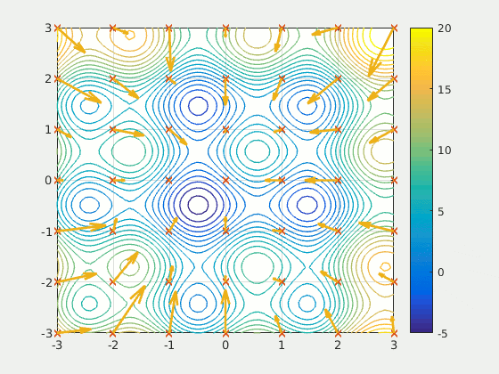
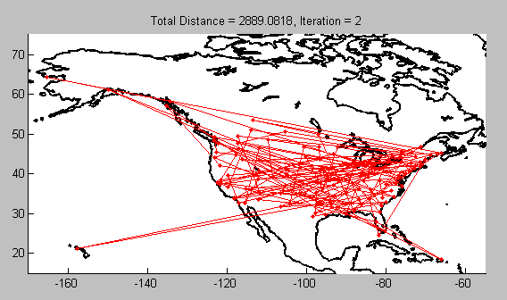
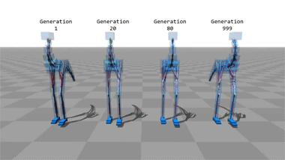
This Lecture
Review Machine Learning (ML)
The Role of Assumptions in ML
Nature Inspired Computing
Evolutionary Algorithms
Genetic Algorithm
Genetic Programming
Rule Based Machine Learning
Learning Classifier Systems

Slide 4
Fields and Terms: Machine Learning
Notes:
Briefly review ML

Slide 5
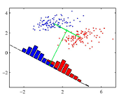
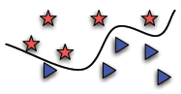
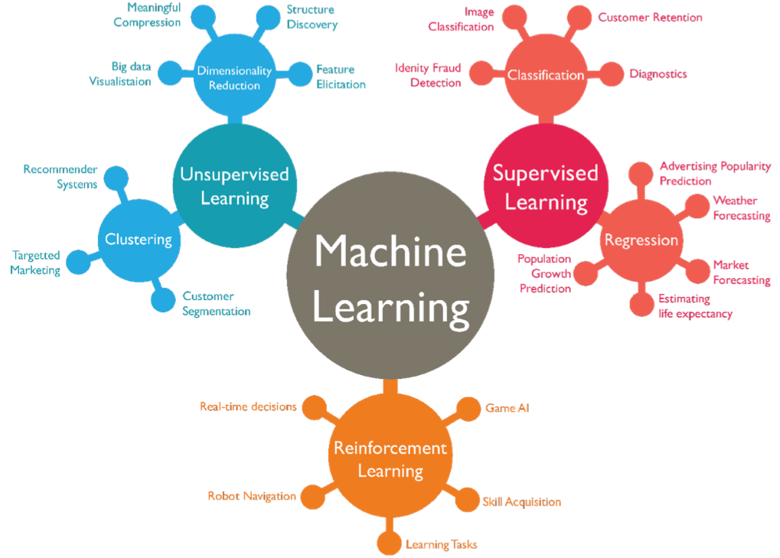
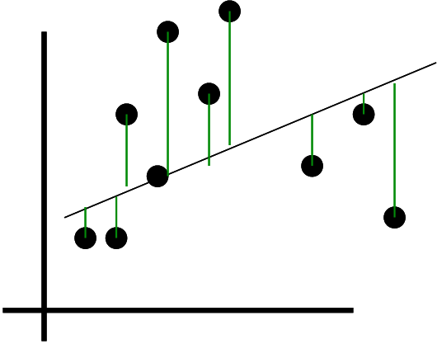



Examples of Machine Learning
Anomaly
Detection
Feature Selection &
Attribute Importance
Labeled Data
Unlabeled Data
Association
Mining
Multi-Step Problems
Adapted from : https://www.pinterest.com/pin/786792997374742269/
Notes:
Briefly Review ML – today we are mainly expanding on Supervised learning methods
Explain RL here.

Slide 6
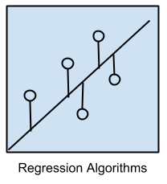
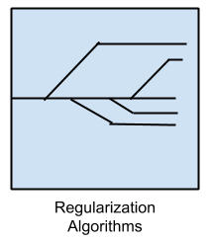
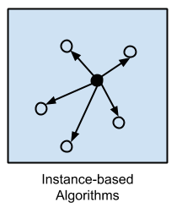
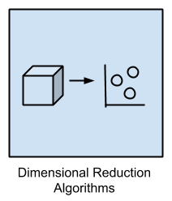
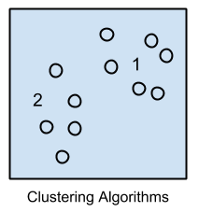
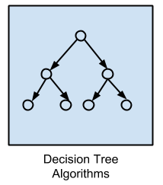
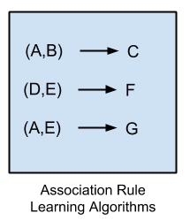
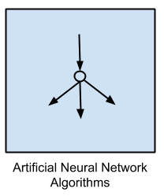
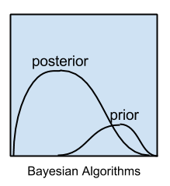
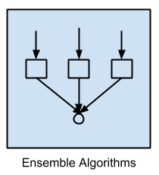
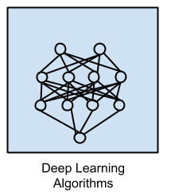

Machine Learning: Algorithm Families
Support Vector
Machines
IF → THEN
Non-exhaustive
list of ML families
IF → THEN
IF → THEN
IF → THEN
Evolutionary
Algorithms
Rule-Based Machine
Learning (e.g. LCS)
Notes:
Review of ML – link to previously discussed methods.
Segway into our discussion on two families of Algorithms (EA and rule based ML)

Slide 7
Where to start in selecting a method?
If there is a strong, simple relationship among variables, most methods will find it.
Generally start with simpler methods if you know nothing about the problem.
Bias can be a key part of machine learning success.
Limiting the hypothesis space with knowledge about the problem
Assumptions!
E.g. If we want to know if there are linear patterns, use linear regression.
Conversely, bias can also be a serious problem when searching for an optimal model.
Incorrect assumptions will limit or invalidate what can be found.
E.g. If we use linear regression to search for non-linear patterns.
Practical considerations…

Slide 8
Considerations When Choosing an ML Algorithm
Training Time - Tied to computational limitations and cost. Some algorithms are more sensitive to ‘big data’ than others, which can make training time intractable.
Number and Importance of Parameters –
‘The knobs a data scientist gets to turn when setting up an algorithm to run’. They are the numbers that affect the algorithms behavior.
The training time and accuracy of an algorithm can be quite sensitive to run parameters. This can require trail and error to find a good combination (i.e. a parameter sweep).
More parameters = greater flexibility and often better accuracy
Harder to explain algorithm, understand, and tune.
Number of features – Certain types of data may have a large number of features relative to the number of data points (e.g. genetic or textual data). This can bog down some algorithms.
Interpretability – In particular if knowledge discovery from data (KDD) is a goal, the representation of the algorithm can have a large impact on how generalizations can be read and interpreted.
Assumptions – Certain algorithms make particular stated or unstated assumptions about the structure of the data or the desired results.
Linearity
Epistatic interactions and dimensionality of interactions
Heterogeneity
Model driven learning (as opposed to data driven or ‘model-free’)
Clean vs. Noisy Signal (some algorithms are more prone to overfitting in noisy problems)
Number of predictive vs. non-predictive features

Slide 9

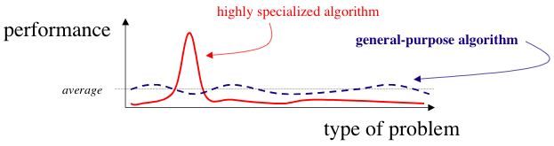
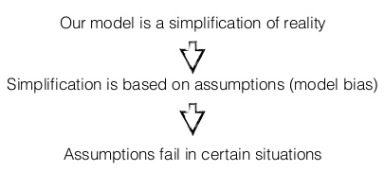
No Free Lunch (NFL) Theorem
“All models are wrong, but some models are useful” – George Box
No single algorithm/model can perform optimally across all problems.
Assumptions that work well in one domain may fail in another.
This theorem indirectly suggests that performance improvement hinges on using prior problem knowledge to match assumptions of algorithms to problem at hand.
Also suggests that the reliability of success should be increased by applying multiple algorithmic approaches as an “ensemble”.
Original theorem developed under strict, ‘unrealistic’ assumptions, open to debate and modification.
NFL does not conflict with the observation that some algorithms will dramatically outperform others in specific problems, or that some algorithms are generally strong performers on a larger spectrum of problems (usually those that make fewer assumptions). “Almost no free lunch”.

Slide 10
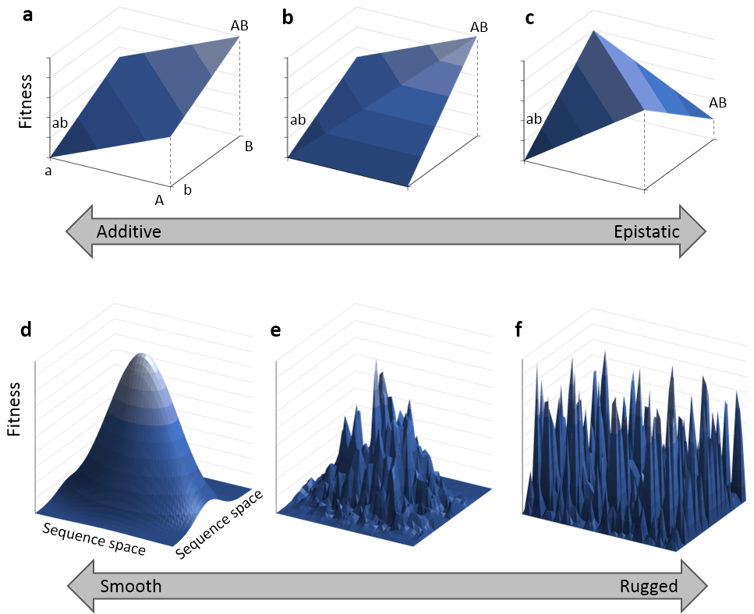
Epistasis (Interactions)
SNP 1
SNP 1
 | AA(.25) | Aa(.5) | aa(.25)
BB(.25) | 0 | 1 | 0 | 0.5
Bb(.5) | 1 | 0 | 1 | 0.5
bb(.25 | 0 | 1 | 0 | 0.5
 | 0.5 | 0.5 | 0.5
 | AA(.25) | Aa(.5) | aa(.25)
 | 0 | 0 | 1
SNP 2
Marginal Penetrance(s)
http://en.wikipedia.org/wiki/File:Epistasis_and_landscapes.png

Slide 11
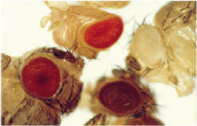
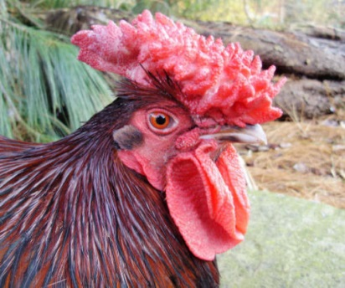
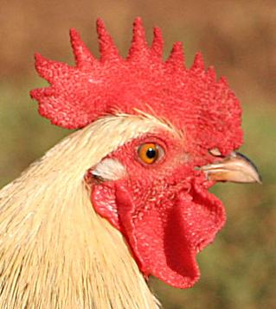

Epistasis
SNP 1
 | AA(.25) | Aa(.5) | aa(.25)
BB(.25) | 0.356 | 0.947 | 0.245
Bb(.5) | 0.912 | 0.437 | 0.599
bb(.25 | 0.210 | 0.758 | 0.165
SNP 2

Slide 12
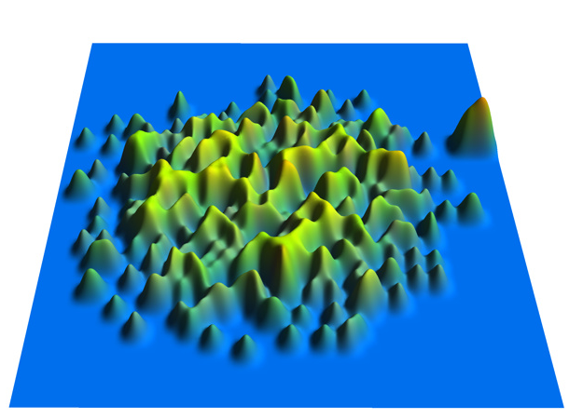

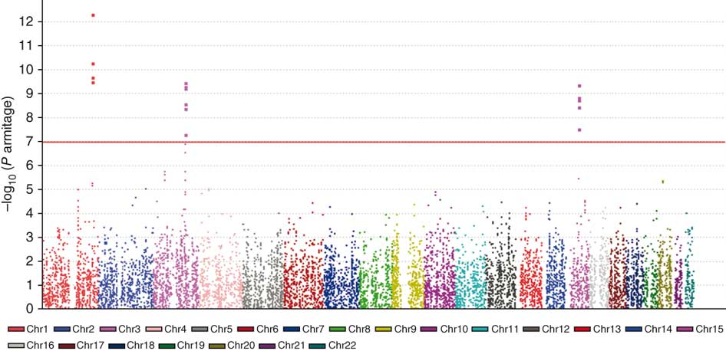
Search Space
The set or domain through which an algorithm searches.
This may be a well-defined and finite data structure, or a vast and possibly infinite set.
Note the algorithm and representation selected can affect the size of the search space.
Example:
Relatively Small Search Space
All possible games of Tic Tac Toe.
Number of Unique Games? (255,168)
Relatively Large Search Space
Genome-wide genetic association study
Assuming 500,000 SNPs and examining linear associations as well as 2, and 3 way interactions.
Number of Unique Regression Models?
(2.08x10^16) ~100 million times greater than the number of stars in the sky (~100 billion)
http://www.se16.info/hgb/tictactoe.htm
http://www.nature.com/ng/journal/v42/n9/abs/ng.645.htm

Slide 13
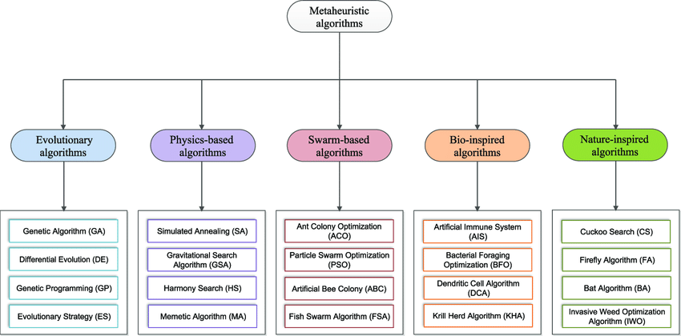
Heuristics and Metaheuristics
Heuristic: (Ancient Greek)- ‘Find’/’Discover’ - Any approach to problem solving, learning, or discovery that employs a practical method not guaranteed to be optimal or perfect, but sufficient for the immediate goals.
Think: Rule of thumb, educated guess, profiling, or reasonable generalizations.
Trial and Error – the most fundamental heuristic.
Metaheuristic: Higher-level procedure designed to find, generate, or select a heuristic that may provide a sufficiently good solution to an optimization problem, especially with incomplete or imperfect information or limited computation capacity
Can sample a search space that is too large to explore completely.
Make few assumptions about the optimization problem, thus they may be useful for a variety of problems.
https://www.researchgate.net/figure/Classification-of-metaheuristic-algorithms_fig1_317068145

Slide 14
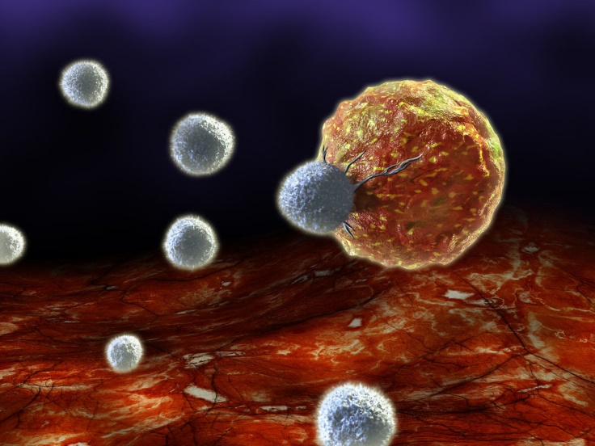
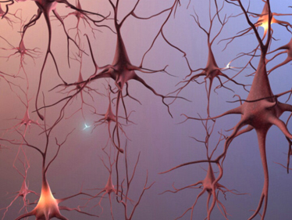
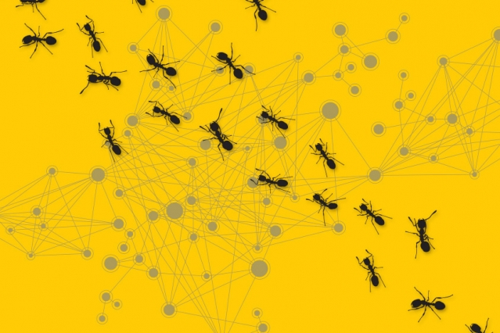
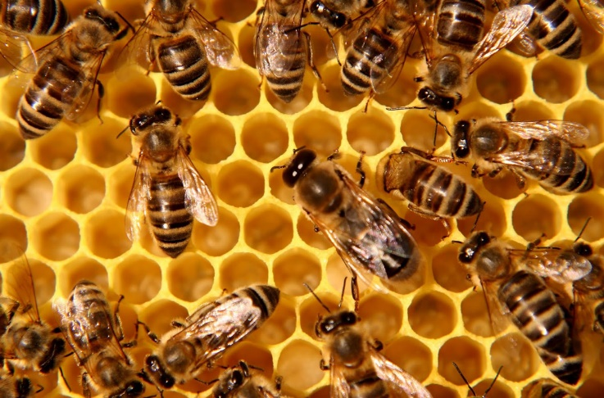


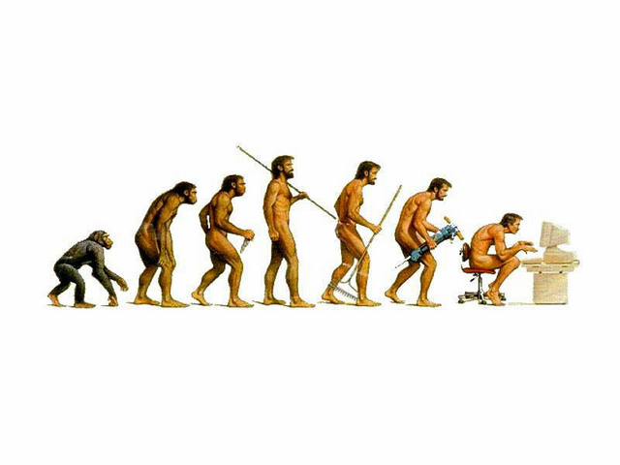
Bio-Inspired Computing

Slide 15
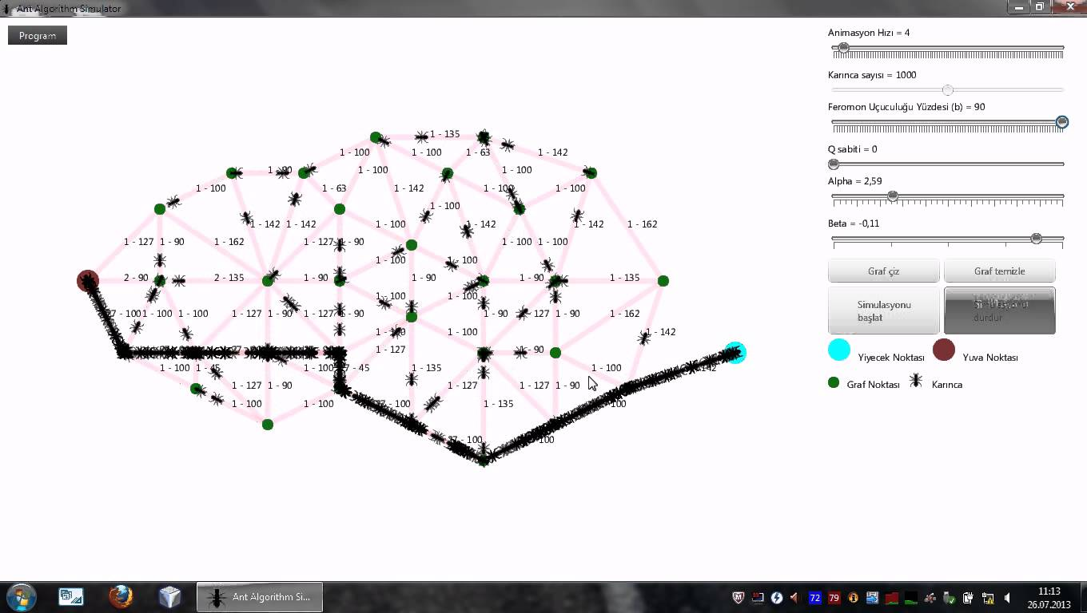
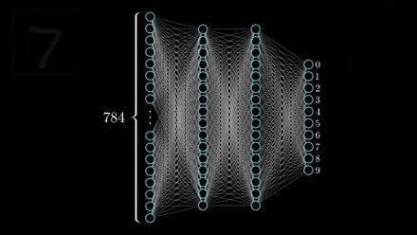
Bio-Inspired Computing: Examples
Ant Colony Optimization
Artificial Bee Colony Algorithm
Artificial Immune Systems
Artificial Neural Networks
Cuckoo Search Algorithm
Evolutionary Algorithms
Firefly Optimization
Fish Optimization
Gene Expression Programming
Genetic Algorithm
Genetic Programming
Learning Classifier Systems
Particle Swarm Optimization
Swarm intelligence

Slide 16
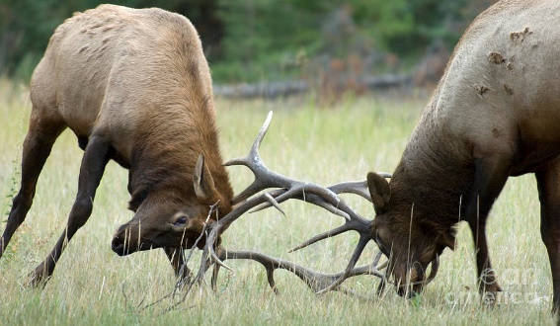
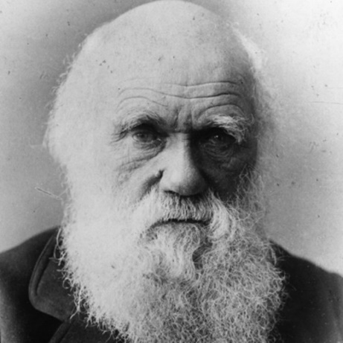
Evolutionary Algorithms (EA)
Based on adopting Neo-Darwinian principles of biological evolution.
Reproduction
Mutation
Recombination
Selection
Survival of the fittest
Belong to the family of ‘trial and error’ problem solvers
Global optimization methods with a metaheuristic or stochastic optimization character.
Stochastic Algorithm – Involves a random component to the search.
Deterministic Algorithm – Given a particular input will always produce the same output.
Population-Based Search – A population of candidate solutions are evolved rather than just one exploring the search space.
Charles Darwin

Slide 17
Evolutionary Algorithms: Examples
Differential Evolution
Evolutionary Programming
Genetic Algorithm
Gene Expression Programming
Genetic Programming
Learning Classifier System
Neuro-evolution

Slide 18

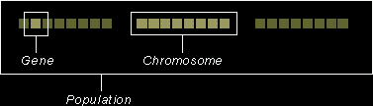
Genetic Algorithm (GA)
Formalized and popularized in mid-1970’s by John H. Holland.
Goal: Evolve a population of candidate solutions in an attempt to identify an optimal, or near optimal solution.
Evolution is modeled after the evolution of organisms using four biological analogies:
Genome/Chromosome → Coded Sequence (commonly a binary string), representing a candidate solution.
Phenotype → Output
Survival of the Fittest → Solution competition
Genetic Operators → New solution discovery
Genetic Representation of Candidate Solutions:
John H. Holland
https://www.doc.ic.ac.uk/~nd/surprise_96/journal/vol1/hmw/article1.html

Slide 19
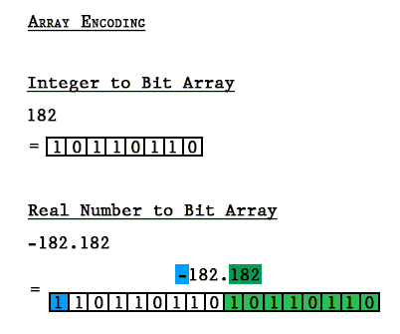
Genetic Algorithm: Genome Representation
Typically each candidate solution is coded as a binary string that forms the genome of an individual.
Typically of fixed length (for simplicity) but can be of variable length.
Features in the data that are already binary are directly encoded (as binary).
Binary encoding strategies have been devised for other variable types.
Think of bits (0,1) as being analogous to DNA base pairs.
http://techeffigytutorials.blogspot.com/2015/02/the-genetic-algorithm-explained.html

Slide 20
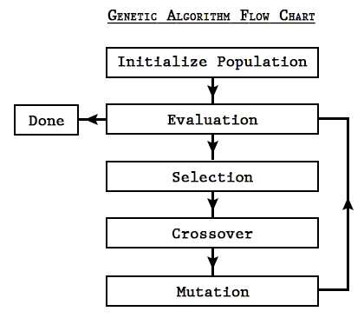
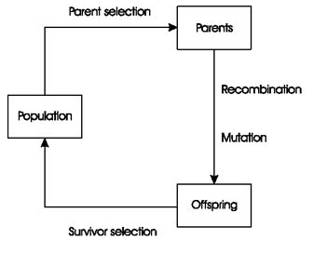
Genetic Algorithm: Training Steps
Initialization:
User defined maximum population size (can be 100’s or 1000’s).
Initial population of individuals randomly generated.
Evaluation:
Determine the ‘fitness’, i.e. quality, of each individual.
Fitness function is critical!
Can be problem dependent, e.g….
Classification problem → Accuracy
Navigation optimization → Total distance
Selection:
Each generation, pairs of parent individuals are selected based on fitness that will be used to generate the next generation of individuals.
Roulette Wheel Selection
Tournament Selection
Genetic Operators:
Create novel offspring individuals based on genome of the parent individuals.
Recombination/Crossover
Mutation
Termination:
Generational process repeated until termination criteria have been reached.
Solution found satisfying evaluation criteria.
Allocated budget (time/generations) reached.
Fitness improvement plateau reached.
Generation
http://techeffigytutorials.blogspot.com/2015/02/the-genetic-algorithm-explained.html

Slide 21
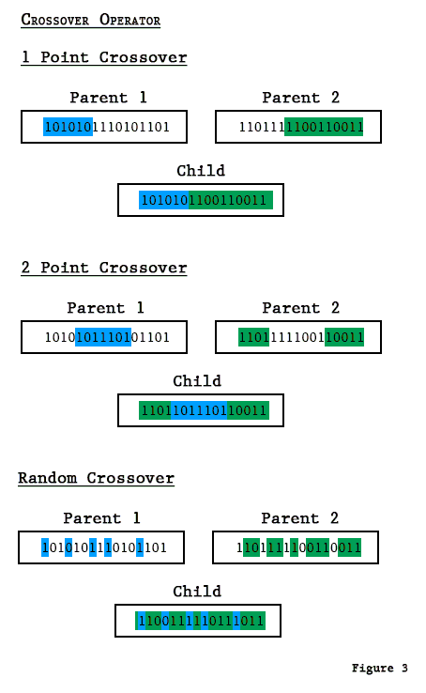
Genetic Algorithm: Crossover

Slide 22
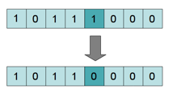
Genetic Algorithm: Mutation

Slide 23
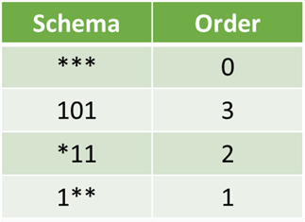
Holland’s Schema Theorem
Why do evolutionary algorithms like a genetic algorithm work?
Holland’s Schema Theorem (i.e. fundamental theorem of genetic algorithms):
Short, low-order schemata that contribute to an above-average fitness, will increase exponentially in successive generations
Assumption: An infinitely large population.
AKA – Building-block hypothesis: Useful building blocks (called schema) will appear and become more prevalent within the population of solutions.

Slide 24
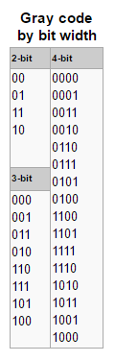
Genetic Algorithm: Major Variants
Chromosome Representation
Others beyond basic bit string
Gray encoding – two successive values differ in only one bit (Hamming Distance Walls)
Selection Mechanism(s)
Deterministic
Roulette Wheel
Tournament Selection
Lexicase Selection
Elitism
Each generation, the top fit individuals carry over to the next, so that the best solutions do not get replaced with poorer ones.
Adaptive Systems
Adaptive run parameters

Slide 25
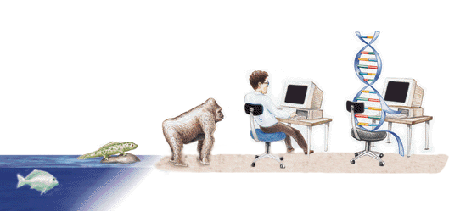
Basic Genetic Algorithm Advantages
Concepts are easy to understand
Intrinsically parallel
Always an answer; answer get’s better with time
Stochastic; intelligently searches intractable problem spaces.
Makes relatively few assumptions about the data.

Slide 26
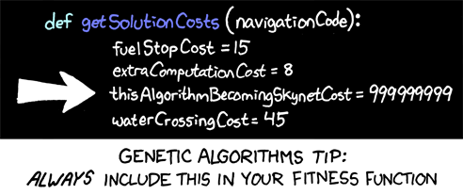
Basic Genetic Algorithm Disadvantages
Can be computationally expensive
May not scale very well with complexity
Not guaranteed to find an optimal solution.
Not adaptive to new information (i.e. dynamic environments)
A number of run parameters to select/optimize.
Difficult to interpret solutions (based on chosen representation).

Slide 27
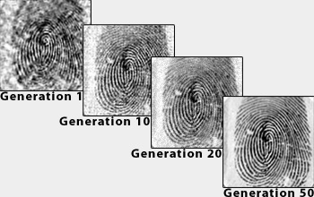
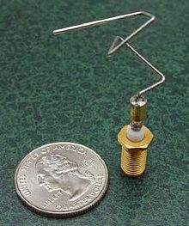
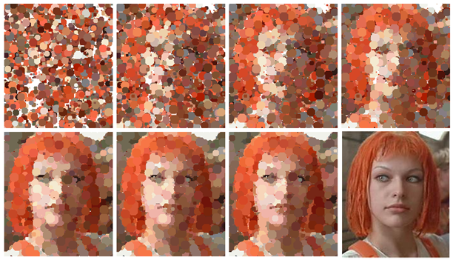
Genetic Algorithm: In Action
https://www.youtube.com/watch?v=Gl3EjiVlz_4

Slide 28
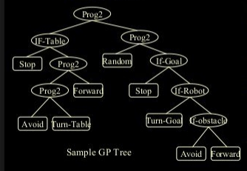

Genetic Programming (GP)
Evolutionary algorithm that evolves computer programs or mathematical/logical functions.
The latter is known as symbolic discriminate analysis (SDA)
Traditionally as tree structures.
Same concept as GA, but with some additional complexity….
Tree depth
Available functions/operators
More complicated genetic operators.
SDA
Uses:
GP could generate epidemiological threshold prediction models.
Feature selection and modeling
“Model-free” – no a priori assumptions about the functional form of the statistical model.
Can effectively model epistatic interactions.
Somewhat interpretable
Particularly well suited to regression problems.
GP: Program for a mobile robot
SDA
Tree
Function

Slide 29

GP Elements
The terminal set
Inputs:
Sensors (Programs)
Variables (SDA)
Constants
The function set

Slide 30


GP Operators
Crossover
Variations of crossover exist that preserve tree depth.

Slide 31

ML Holy Grail: Agnostic ML
Learning Objectives:
Modeling (Accurate and Generalizable)
Prediction (Accurate on ‘new’, unseen instances)
Interpretation/Knowledge Discovery (Power to identify underlying associated risk factors and characterize the respective pattern of association
Agnostic approaches minimize assumptions:
Pattern of association
Main effects
Additive effects
Epistasis
Heterogeneity
Pleiotropy
Number of predictive variables
Data properties
Dimensionality (# of samples and variables)
Missing data
Imbalanced data
Endpoint type (discrete or continuous) (classification vs. regression)
Variable type (discrete or continuous)
Clean vs. noisy signal

Slide 32


Heterogeneity
Subjects with Disease of Interest
G3
G4
G5
G7
G8
G1
G2
E1
Cystic Fibrosis
Retinitis Pigmentosa

Slide 33

Handling Heterogeneity?
Cluster Stratification
Covariate Stratification
Cases
Dataset
Controls
Best Model
Best Model
Best Model
dataset
Best Model
Best Model
Best Model

Slide 34

Heterogeneity in Precision Medicine

Slide 35
Rule-Based Machine Learning (RBML)
RBML = A General Paradigm of Machine Learning
Rule-Based – The solution/model/output is collectively comprised of individual rules typically of the form (IF: THEN).
Machine Learning – “A subfield of computer science that evolved from the study of pattern recognition and computational learning theory in artificial intelligence. Explores the construction and study of algorithms that can learn from and make predictions on data.” – Wikipedia
What types of algorithms fall under this label?
Learning Classifier Systems (LCS)*
Michigan-style LCS
Pittsburgh-style LCS
Association Rule Mining
Artificial Immune Systems
Keep in mind that machine learning algorithms exist across a continuum.
Hybrid Systems
Conceptual overlaps in addressing different types of problem domains.

Slide 36




Types of Rule-Based Machine Learning
Link between these methods?
The defining characteristic is the identification and utilization of a set of relational rules that collectively represent the knowledge captured by the system (piece-wise). This is in contrast to other machine learners that commonly identify a singular model that can be universally applied to any instance in order to make a prediction.
Association Rule Mining (ARM)
Developed primarily for discovering interesting relations between variables in large datasets.
IF:THEN rules link independent variable(s) to some other independent variable e.g. {V₁, V₂, V₃} → V₄
Artificial Immune Systems (AIS)
Developed primarily for anomaly detection (i.e. differentiating between self vs. not-self)
Multiple `Antibodies’ (i.e. detectors) are learned which collectively characterize ‘self’ or ‘’not-self’ based on an affinity threshold.
Learning Classifier Systems (LCS)
Developed primarily for modeling, sequential decision making, classification, and prediction in complex adaptive system .
IF:THEN rules link independent variable states to dependent variable states. e.g. {V₁, V₂, V₃} → Class/Action

Slide 37

Learning Classifier Systems (LCS)
Rule-based algorithms.
Combine:
Global search of evolutionary computing (ideas from nature)
Local optimization of machine learning
Output: A distributed and generalized probabilistic prediction model.
Key Differences:
Incremental Learning
Distributed, Rule-Based Model
Minimal Assumptions

Slide 38
Learning (Instance Presentation)
Batch Learning (Offline)
Incremental Learning (Online)
Algorithm
Algorithm
All Data
Dataset
Environment
Or Dataset
01100011

Slide 39
Challenging the Paradigm of Modeling
Problem
Space
Most Machine Learning Models
Data
Model
Prediction
Determined
For Each
Any Data Point
Rule-Based Machine Learning Models
Model (Set of rules)
Data
Prediction
Determined
From
Relevant Rules
Specific Data Point
Relevant Rule(s)
(i.e. colored boxes) Activated

Slide 40


Piecewise Learning Paradigm

Slide 41
6-Bit Multiplexer Problem (Model of Epistasis & Heterogeneity)

Slide 42
Piecewise Solution to 6-Bit Multiplexer

Slide 43

n-Bit Multiplexer Problem Benchmark
TO SOLVE: Any Multiplexer
No single attribute has any association with endpoint
Only a certain subset of attributes is predictive for a given individual belonging to an underlying subgroup (i.e. latent class)
TO SOLVE: 135-bit Multiplexer
All 135 attributes are predictive in at least some subset of the dataset.
Non-RBML approaches would need to include all 135 attributes together in a single model properly capturing underlying epistasis and heterogeneity.
Notes:
Atoms in a human 20^27, atoms in planet 10^49, stars in known universe 10^23

Slide 44
Watch LCS Video (13 min)

Slide 45
Generic Learning Classifier System

Slide 46

Extended Supervised Tracking and Classifying System
Goal: Develop a machine learning algorithm that limited assumptions and maximized application flexibility within the context of supervised learning problems.
Geared towards bioinformatics and genetic epidemiology applications.
Can successfully model epistatic and heterogeneous patterns in an interpretable manner.
Can identify heterogeneous candidate patient subgroups without prior knowledge.
First and only algorithm in the world to report solving the 135-bit multiplexer problem directly.

Slide 47




A
INPUT
Pre-Processing: Expert Knowledge Discovery
1
Data Set
10
Deletion
Expert Knowledge
Training Instance
2
Post-Processing: Rule Compaction
[P]
C
5
Genetic
Algorithm
[C]
B
Covering
9
[P_{C} ]
3
7
Attribute Feedback
Prediction
[M]
Subsumption
4
[I]
[C]
8
Attribute Tracking
LCS: Michigan-Style Rule-Based Algorithm
Update Rule
Parameters
6

Slide 48




Improving Performance and Interpretability
Attribute Tracking/Feedback
Characterize heterogeneity
Speed up learning with useful
building blocks.
Expert Knowledge Guided Rule Discovery
EK probabilistically weighting
mutation, crossover, and covering.
Rule Compaction
NONE
Fu2
PDRC

Slide 49


Knowledge Discovery: Manual Rule Inspection
.50
.50
X0
X1
X2
X3

Slide 50



Rules in Population
Attributes
#
0,1,2

Slide 51

Pairs

Slide 52


Bladder Cancer Investigation: Rule Population

Slide 53


Clinical Variable Analysis: CASES: Survivorship
B
BAD
D
p < 0.05

Slide 54
The Future for Evolutionary Algorithms and Rule Based ML
Offer great potential:
Limit assumptions
Flexible
Adaptable
Accommodate large search spaces
Offer paths to interpretability
Main Challenges:
Fitting the problem to a method and it’s parameters.
Use prior knowledge of problem to chose method makes reasonable simplifying assumptions to (constrain search space) and solve problem.
Select a diverse ensemble of methods (each with unique assumptions) and hope that at least one will be suited to the problem.
Utilize an auto-ML approach. (throw against wall and see what sticks)
Work towards developing methods that can adapt to the problems themselves. (adapting/minimizing assumptions)
The most fundamental assumption, is often, what constitutes a ‘good’ solution?

Slide 55




ML as the “Dumb” but Powerful Animal
ML is a powerful tool that can get you to where you want to go, but you need to guide it properly (e.g. measures of success) and give it the context within which to succeed (e.g. feature engineering).
Anecdote: Calculating Mean
i.e. measures of central tendency
Arithmetic mean
Geometric mean
positive numbers, mean of consecutive growth factors, e.g. capital growth
Harmonic mean
average of rates, e.g. cost per item
e.g. [4, 36, 45, 50, 75]
= 42
= 30
= 15

Slide 56
E.g. Distance Matrix Calculation [1 of 3]
Extending this anecdote beyond calculation of mean…
Consider problem of classifying reptile vs. non-reptile by measuring distance between animals¹.
Feature engineering
What features are useful?
How do we evaluate distance?
Class
Label
Features
Name | Egg-laying | Scales | Poisonous | Cold-blooded | # Legs | Reptile
Cobra | 1 | 1 | 1 | 1 | 0 | 1
Rattlesnake | 1 | 1 | 1 | 1 | 0 | 1
Boa Cons. | 0 | 1 | 0 | 1 | 0 | 1
Chicken | 1 | 1 | 0 | 0 | 2 | 0
Alligator | 1 | 1 | 0 | 1 | 4 | 1
Dart Frog | 1 | 0 | 1 | 0 | 4 | 0
Salmon | 1 | 1 | 0 | 1 | 0 | 0
Python | 1 | 1 | 0 | 1 | 0 | 1
 | Binary | Binary | Binary | Binary | Int
¹ http://www.mitocw.espol.edu.ec/courses/electrical-engineering-and-computer-science/6-0002-introduction-to-computational-thinking-and-data-science-fall-2016/lecture-slides-and-files/MIT6_0002F16_lec11.pdf
Eric Grimson - MIT

Slide 57

E.g. Distance Matrix Calculation [2 of 3]
Considerations for calculating a distance matrix for ML .
Euclidean distance (‘as bird flies’ distance)
Manhattan distance (‘block-wise’ distance)
Hamming distance (binary distance, different or the same)
How do we want the machine to interpret “distance”?
Is it the magnitude of a difference in a given feature that should weight distance predominantly?
Is it the number of features where a difference is observe?
Consider distance matrix for classifying reptiles from non-reptiles…
¹ http://www.mitocw.espol.edu.ec/courses/electrical-engineering-and-computer-science/6-0002-introduction-to-computational-thinking-and-data-science-fall-2016/lecture-slides-and-files/MIT6_0002F16_lec11.pdf
Eric Grimson - MIT

Slide 58


E.g. Distance Matrix Calculation [3 of 3]
Original Encoding (Euclidean Dist.)
Rattlesnake = [1,1,1,1,0]
Boa Const. = [0,1,0,1,0]
Dart Frog = [1,0,1,0,4]
Alligator = [1,1,0,1,4]
Binary Encoding (Hamming Dist.)
Rattlesnake = [1,1,1,1,0]
Boa Const. = [0,1,0,1,0]
Dart Frog = [1,0,1,0,1]
Alligator = [1,1,0,1,1]
¹ http://www.mitocw.espol.edu.ec/courses/electrical-engineering-and-computer-science/6-0002-introduction-to-computational-thinking-and-data-science-fall-2016/lecture-slides-and-files/MIT6_0002F16_lec11.pdf
Eric Grimson - MIT

Slide 59
Rule-base ML Problem: Rule Fitness
Problem extends to any EA (where solution goodness is defined by a ‘fitness’)
Rule-accuracy alone is an ineffective metric/indicator of global rule value. (Consider simple example of accurate rule that matched only one training instance)
Accuracy-driven overfitting in noisy problems leads to poorer knowledge discovery. (Consider that in noisy problems an ‘optimal’ rule would never achieve perfect accuracy)
Possible Solutions:
Multi-objective fitness (static metric)
Adaptive fitness (Pareto-inspired)
# 1 0 # # ~ 0

Slide 60


Typical ML Pareto Front
Based on concepts introduced by Vilfredo Pareto (1848-1923), engineer and economist in his studies of economic efficiency and income distribution.
Pertains to optimal trade-offs between items/objectives.
Front is defined by non-dominated points that can represent engineering designs or prediction models.
Drawbacks:
You typically need to pick a solution from the front. This would require knowledge of the problem (i.e. how to weight one objective over the other) to help guide selection of solution.
Designed for comparing and selecting ‘complete’ models or solutions.

Slide 61
Pareto Front (i.e. Non-dominated Front)
Theoretical Optimum
Non-dominated Point (Blue)
Dominated Point (Red)
Objective 1
Objective 2

Slide 62
New Rule – Calculate Fitness
Rule Accuracy
Correct Coverage

Slide 63
Distance From Rule
Point to Pareto Front
Rule Accuracy
Distance From Origin
to Rule Point
Correct Coverage

Slide 64


Pareto-Based Rule Fitness Gradient

Slide 65

The Objective is not (necessarily) the objective function…
Extending the discussion of solution ‘goodness’, i.e. fitness to drive evolutionary search.
Maze example:
Solution = a robot behavior policy that allows it to reach the goal in a certain number of moves.
Search space = all possible behavior policies given robot constraints.
Objective = goal, or optimal solution
Objective function = the manner by which fitness is calculated/determined.
Observation: Using the goal to define fitness of candidate solutions, may not allow the optimal behavioral policy to be learnable.
Sipper M., Urbanowicz R., Moore J. To know the objective is not (necessarily) to know the objective function. BioData Mining 2018

Slide 66


Learn more about Learning Classifier Systems
YouTube Video on LCS:
https://www.youtube.com/watch?v=CRge_cZ2cJc
Textbook: Introduction to Learning Classifier Systems [Urbanowicz & Brown, 2017]. Springer. 2017. (Available on Amazon)

Slide 67
Practicum (Optional)
Educational LCS (eLCS)
https://github.com/ryanurbs/eLCS
ExSTraCS
https://github.com/ryanurbs/ExSTraCS_2.0

